Slide 1
System Development Methods CT00046-3-2
Structured Methodologies

Slide 2
Topic & Structure of the Lesson
Introduction to Structured Methodologies
Techniques and Tools

Slide 3
Learning Outcomes
By the end of this lecture, YOU should be able to :
Identify and explain the underlying principles for Systems Development Methodology

Slide 4
Key Terms you must be able to use
If you have mastered this topic, you should be able to use the following terms correctly in your assignments and exams:
IS Structured Methodologies
Techniques and Tools
Waterfall Model
SSADM
V-Model

Slide 5
Era of IS Methodologies
IS Methodologies
Traditional / Structured Methodologies
Modern Methodologies
Late 70s’ to early 90s’
(Ex; SSADM, Waterfall, V-Model, etc)
Late 90s’ to today
(Ex; Scrum, RAD, DSDM, etc)

Slide 6

Structured Methodologies
Developed in the 70’s
Mostly Traditional Methodologies
Very detailed steps explained
Formulation for beginners to develop a system.
Requirements need to be clear and fixed.
Focus on error free product
Rigid and strict rules
Emphasis on full documentation.
Example methodologies;
Waterfall Model, SSADM, V-Model
(we will take a look at these three)

Slide 7
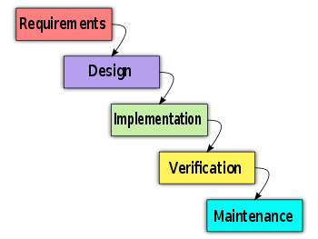
Waterfall Model
Close to SDLC phases
Can be used for almost all types of projects
Highly structured and rigid - sequential development process
One should move to the next phase only when its preceding phase is completed and perfected.
Promotes quality control of process and product.
Good for beginners.
Emphasis on good documentation

Slide 8
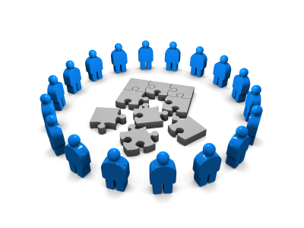
Waterfall Model Stages
Requirement Gathering and analysis
All possible requirements of the system to be developed are captured and documented into System Requirement Specification (SRS) document.
System Design
The SRS is studied and system design is prepared.
System Design helps in specifying hardware and system requirements and also helps in defining overall system architecture.
Implementation
With inputs from system design, the system is first developed in small programs called units, which are integrated in the next phase.
Each unit is developed and tested for its functionality which is referred to as Unit Testing.

Slide 9
Waterfall Model Stages .. cont
Integration and Testing
All the units developed in the implementation phase are integrated into a system after testing of each unit.
Post integration the entire system is tested for any faults and failures.
Deployment of system
Once the functional and non functional testing is done, the product is deployed in the customer environment or released into the market.
Maintenance
There are some issues which come up in the client environment. To fix those issues patches are released.
Also to enhance the product some better versions are released.

Slide 10
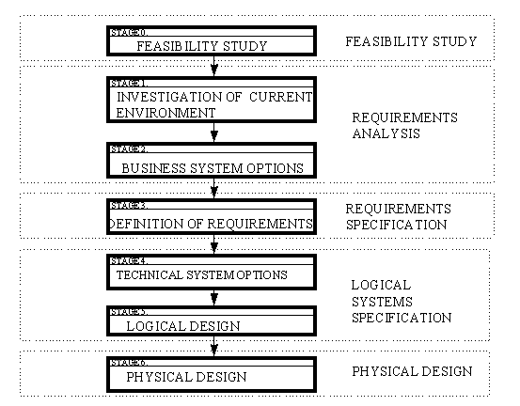
Structured Systems Analysis And Design Method (SSADM)
Popular methodology used in the late 80s
Rigid and document-led approach to system design
Have detailed DESIGN stage.
Good for projects with database design.
Has strategies to align business needs with system development.
Ends at design stage.

Slide 11
SSADM Techniques
Logical Data Modeling
To determine the high level requirement for the system
System components, entities, main process, etc.
Data Flow Modeling
To determine the ‘movement’ of data within the system
Data transformation, storage, data flow, etc.
Entity Event Modeling
To determine the processes and operations
Event sequence, dependency, etc.

Slide 12
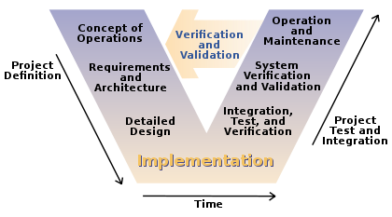
V-Model
Derived and modified from Waterfall Model
Emphasize of ‘check and balance’ of development process

Slide 13

V-Model Techniques
Takes the ‘top-down’ development approach
Concept, Architecture Design, high level design, etc.
Verification and Validation at end of each phase / process.
Referring back to project documentation, objectives, scopes, requirements, specifications, etc.
Users are consulted for verification and validation.
Use various testing techniques for product
Unit, integration, system, user acceptance, etc.

Slide 14
Quick Quiz
Explain to your class, the process flow within a V-Model?

Slide 15

Problems with Structured Methodologies (in general)
Rigid phases, discourage skipping of unimportant steps.
Emphasize of process and product quality rather then customer satisfaction
Requirement need to be defined in the beginning of the project and not encouraged to change towards the end.
Cost and time often unpredictable for large projects.
Too many ‘red-tapes’, wasting time and resources

Slide 16
Question & Answer

Slide 17
Next Session
Agile Methods

Slide 18
Tutorial Questions
Find names of a few popular methodologies used today. What are the types of project that they are used for?
Discuss the advantages using IS Development Methodologies.
Discuss the distinctive disadvantages using the following IS Development Methodologies.
Waterfall model
SSADM
V-Model

